Slide 1
Strategic Growth through Smart Ventures
A Publicly Traded Real Estate Asset Management and Business Acquisition Company
Investor Presentation

Slide 2
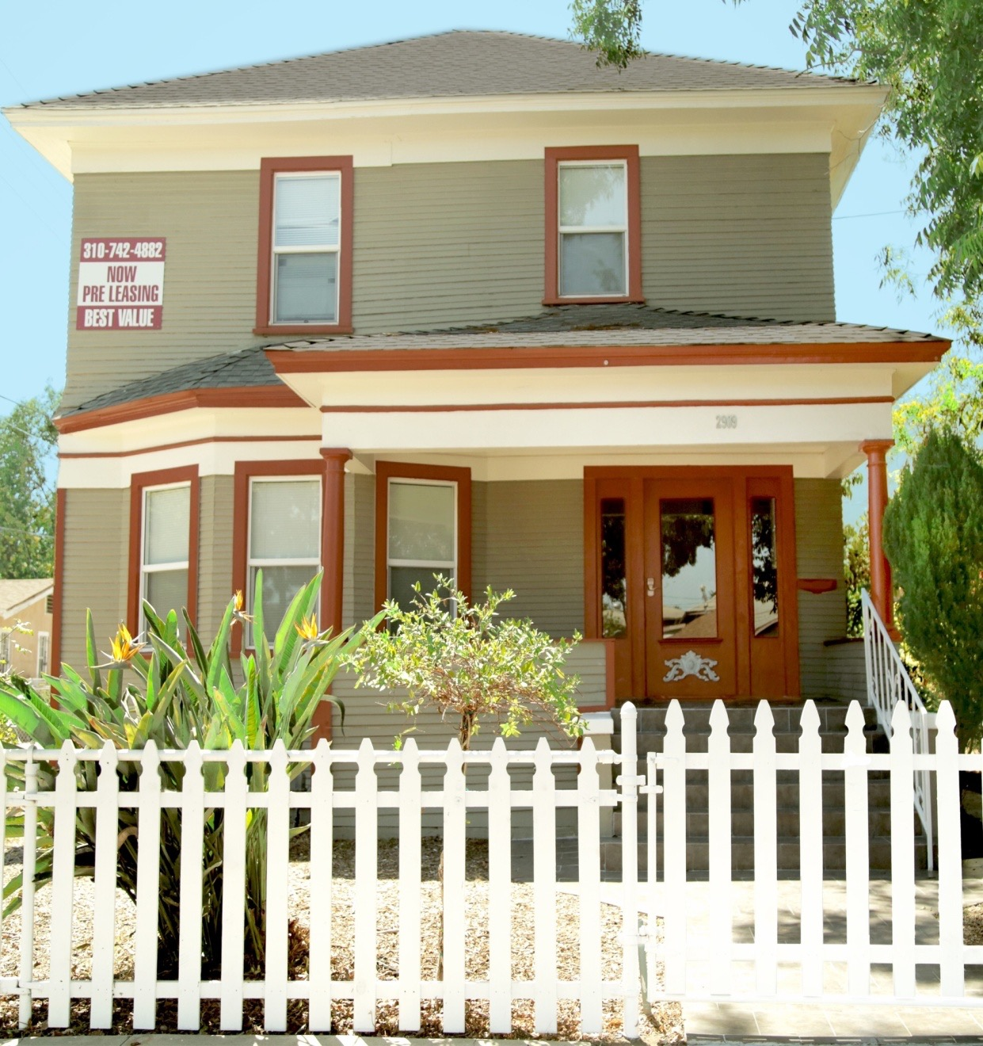
Executive Summary
Unique opportunity to invest in a growing public company focused on real estate asset management and business acquisitions we believe offer strong cash flow upside and equity appreciation within the three complimentary and attractive niche markets of:
Student housing adjacent to USC campus and other high end universities which offer recession proof stability and top of the market value on rents.
Development of multi-family properties within walking distance of newly constructed Los Angeles Metro/subway stations, taking advantage of upside density, zoning changes​, and higher rents.
Acquisitions of profitable high growth businesses in the industries of Business Services (Property Management, Clean Tech (Green), Healthcare Services, I.T./Cloud) and e-Commerce (B2B, B2C) operating in Southern California.
Current capital raise of $2,000,000 is expected to be first in a series of capital raises targeting a strategy of maximizing the current growth and urbanization in Los Angeles.

Slide 3
The Future of Hubilu
Build a solid personnel team to ensure future expansion​
Develop public awareness of the company through social media, public ​relations
organic marketing, website and real estate broker awareness ​
Build out systems including administration, CRM & property management
software
Raise capital using convertible preferred stock​ and debt placement
Expand our shareholder base to 500 shareholders​
Acquire properties and businesses to establish a minimum of $4MM in net
worth​
Secure lines of credit to ensure fast closings of acquisition opportunities​
Rapidly increase property and business acquisitions through portfolio
investments​
Move to NYSE or NASDAQ main board ​
Focus on institutional financing and investors​
Target development opportunities and large scale student housing opportunities​
Expand to other college student high growth cities
Year 1
Year 2
Year 3

Slide 4
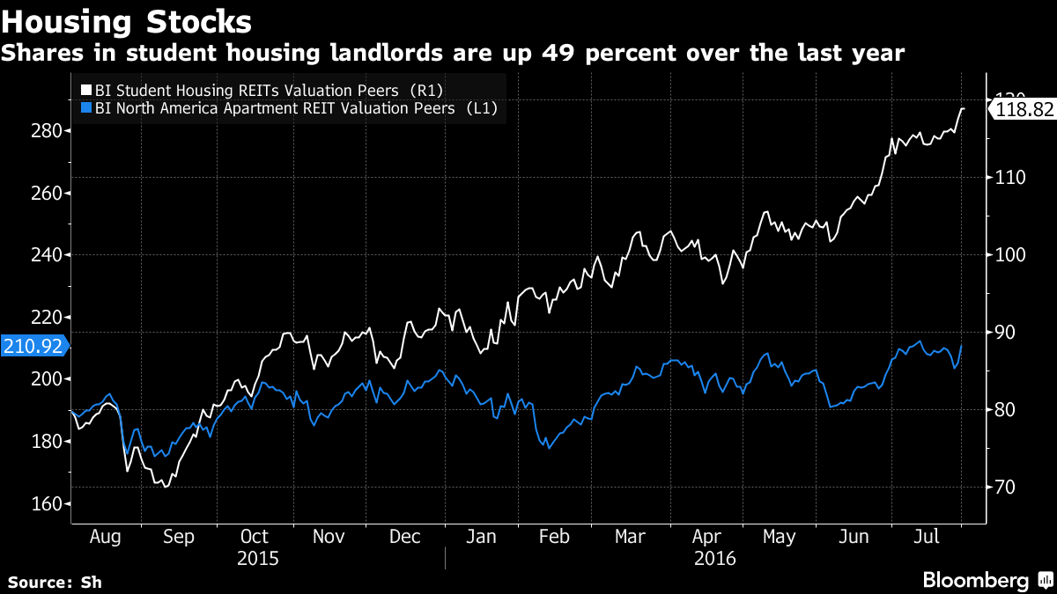
Why student housing
Off Campus Student Housing began in the mid 90’s, it’s an infancy industry with high growth potential, with many real estate investors capitalizing on the premium rents and lack of housing on university campuses..
Why Student Housing is Growing:::
Stable and Rising College Enrollment
Demand Exceeds Supply
Students Desire Homelike Amenities
Lower Off-Campus Housing Costs
Capital Constraints on Universities
Recession Proof Industry
Premium Market Rents Year Round
Average monthly rents of a unit in the USC area rose from approximately $750 in 2005 to $1,500 in 2016​ and student enrollment at USC has grown from 32,000 in 2005 to 44,000 in 2016, with 25,000 being graduate students.

Slide 5
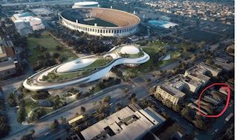
Path of Growth Areas
Emerging path of growth areas create more jobs, which means the demand for housing rises and needs fulfilled. Exposition Park, home of LA Memorial Coliseum and Banc of California Stadium, the Natural History Museum, California Science Center and the new 1 Billion Dollar George Lukas Museum is a great example of this path. Circled in the picture on the right is our latest acquisition which is a block from this emerging area.
New Museum Predicts Thousands of Jobs Will be Created
Housing Demand Exceeds Supply
Housing Rents and Resale Value will Rise
World Wide Draw to the Area
LA Coliseum Will be Home of the 2024 Olympics
11 Acres of Green Space will Draw Family Friendly Festivals, Outdoor Film Screenings, and Educational Activities
Situated Close to USC Campus

Slide 6
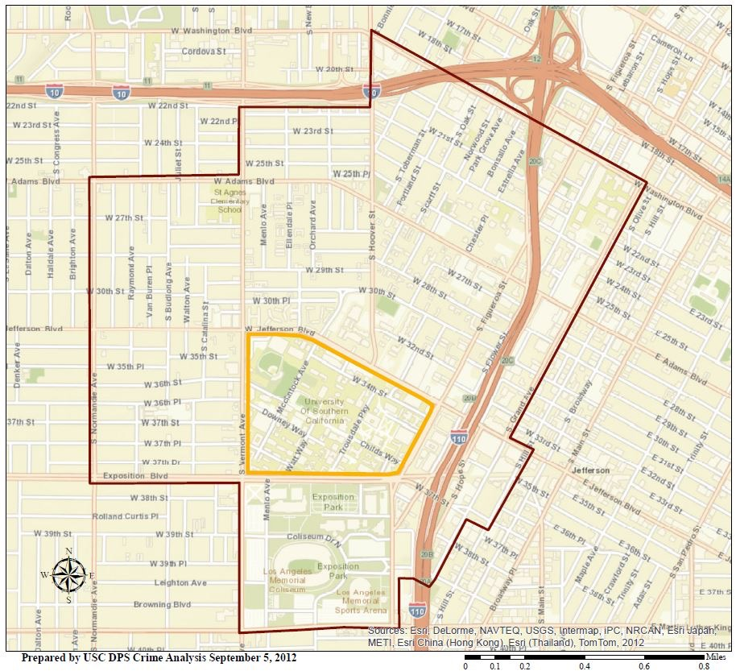
Opportunity Map
Geographic Footprint from USC to Staples Center.
The Black Outline around the USC Campus in the map below delineates the USC Security Patrol Area.

Slide 7
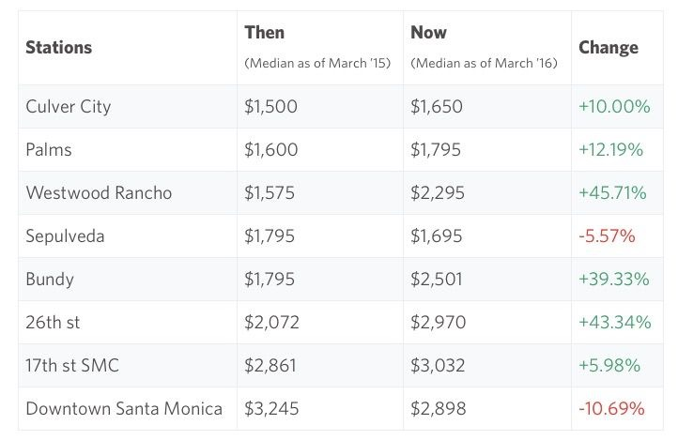
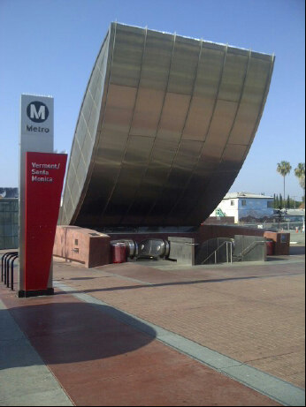
Los Angeles Metro / Subway Expansion
Hubilu will target properties located within walking distance of the expanding transportation system hubs.
In addition to on-demand car service availability, tenants benefit by being near the LA Metro/subway stations, eliminating
the need and costs for personal vehicles and parking.
Development opportunities will increase as the City encourages more density around the LA Metro/subway systems
to help minimize vehicle congestion and pollution levels.
Increased rents and development opportunities will result in higher values and a greater return on investment

Slide 8
Property OWNED | Los Angeles
2909 S. Catalina Ave., Los Angeles
Hubilu acquired this 9 bedroom SFR located 3 blocks from USC Campus. Property is in turn-key condition, cash-flow positive, and close to USC Village. Purchase price $925,000. Cap Rate 7.2%
Rental Unit | Current Monthly Rent | Future Monthly Rent | Close of Escrow
1 | $789 | $813 | Current Valuation | $925,000.00
2 | $789 | $813
3 | $789 | $813 | Purchase Price | $925,000.00
4 | $789 | $813
5 | $789 | $813
6 | $789 | $813 | Current Valuation | $925,000.00
7 | $789 | $813 | Mortgage | ($670,000)
8 | $789 | $813
9 | $789 | $814 | Equity | $255,000.00
Total | $7,100 | $7,318
Note: Tenants Pay | All Utilities |  | Current Annual Rent | $85,200
Current Annual Rent | $85,200 | $87,816 | Est. Annual Expenses | ($18,500)
Est. Annual Expenses | ($18,500) | ($18,500) | Annual Debt Service | ($40,200)
Annual Net Cash Flow | $66,700 | $69,316 | Annual Net Cash Flow | $26,500
Purchase Price | $925,000 | $925,000 | Principal Reduction | $10,400
Actual Cap Rate | 7.2% | 7.5% | Total Return | $36,900

Slide 9
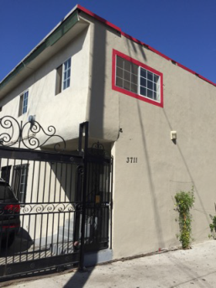
Property OWNED | Los Angeles
3711 S. Western Ave., Los Angeles
Hubilu acquired this 9 unit property located close to the Metro/subway station and USC Campus. Property is in turn-key condition and is cash-flow positive. Purchase price $890,000.
Rental Unit | Current Monthly Rent | Future Monthly Rent | Close of Escrow
1 | $675 | $680 | Current Valuation | $890,000
2 | $1003 | $1025
3 | $1003 | $1025 | Purchase Price | $890,000
4 | $825 | $850
5 | $825 | $850
6 | $872 | $895 | Current Valuation | $890,000
7 | $772 | $825 | Mortgage | ($710,000)
8 | $1003 | $1025
9 | $1358 | $2250 | Equity | $180,000
Total | $8,336 | $9,425
Note: Tenants Pay | All Utilities |  | Current Annual Rent | $100,032
Current Annual Rent | $100,032 | $113,100 | Est. Annual Expenses | ($35,485)
Est. Annual Expenses | ($35,485) | ($35,485) | Annual Debt Service | ($36,210)
Annual Net Cash Flow | $64,547 | $77,615 | Annual Net Cash Flow | $28,337
Purchase Price | $890,000 | $890,000 | Principal Reduction | $10,800
Actual Cap Rate | 7.3% | 8.7% | Total Return | $39,137

Slide 10
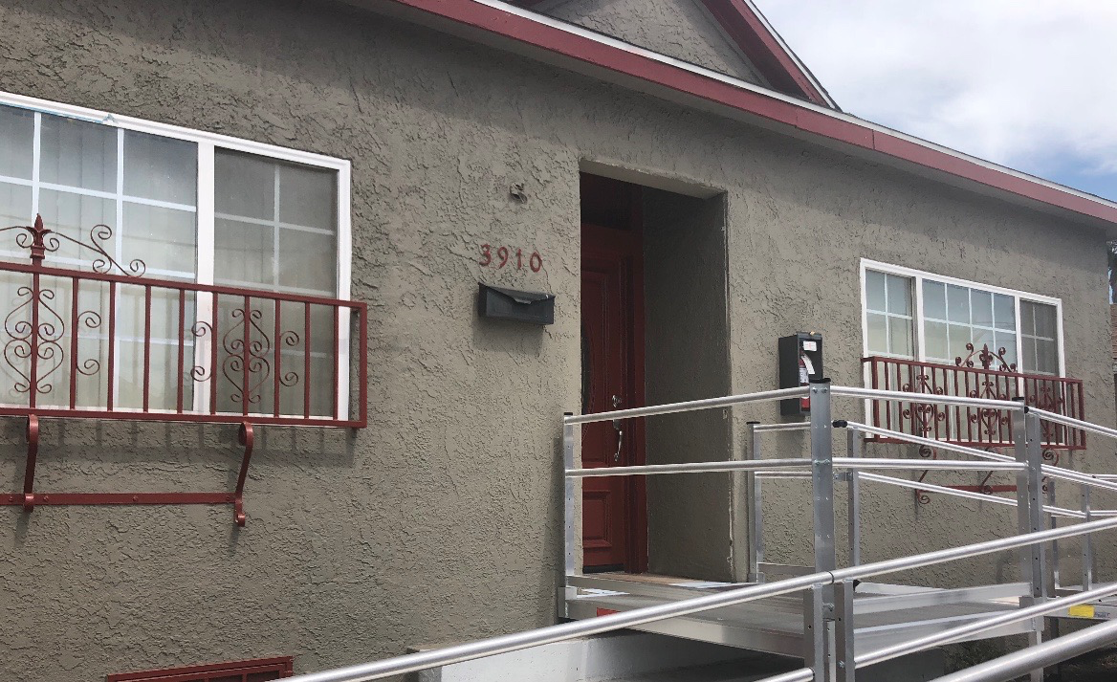
Property OWNED | Los Angeles
3910 Walton Ave., Los Angeles
Hubilu acquired this 6 bedroom property located 3 blocks from USC and the LA Metro/subway station. Property is in turn key condition, ADA approved and is cash-flow positive. Purchase price $510,000.
Rental Unit | Current Monthly Rent | Future Monthly Rent | Close of Escrow | 510,000
1 | $950 | $985 | Current Valuation | $750,000
2 | $950 | $985
3 | $900 | $925 | Purchase Price | $510,000
4 | $900 | $925
5 | $900 | $925
6 | $900 | $925 | Current Valuation | $750,000
 |  |  | Mortgage | ($2,550)
 |  |  | Equity | $240,000
Total | $5,500 | $5,670
Note: Tenants Pay | All Utilities |  | Current Annual Rent | $66,000
Current Annual Rent | $66,000 | $68,040 | Est. Annual Expenses | ($9,925)
Est. Annual Expenses | ($9,925) | ($9,925) | Annual Debt Service | ($30,600)
Annual Net Cash Flow | $56,075 | $58,115 | Annual Net Cash Flow | $25,475
Purchase Price | $510,000 | $510,000 | Principal Reduction
Actual Cap Rate | 11% | 11.4% | Total Return | $25,475

Slide 11
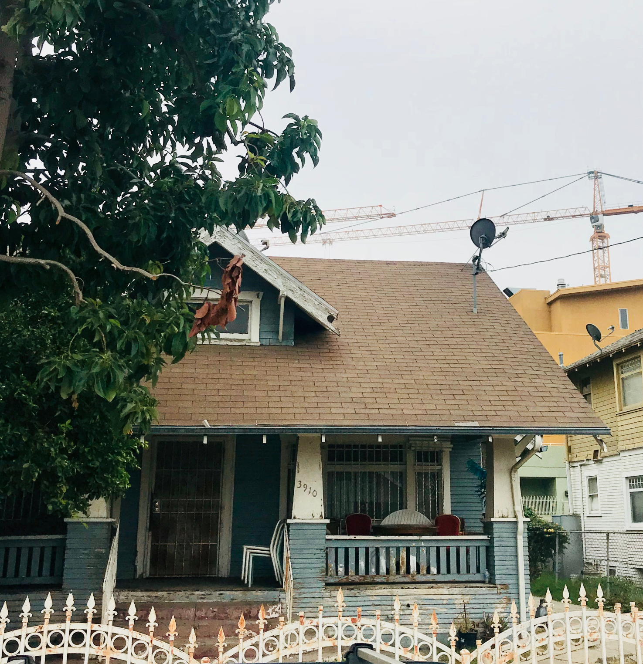
Property OWNED | Los Angeles
3910 Wisconsin Avenue., Los Angeles
Hubilu acquired this 7 bedroom property located near USC and 1 block from Exposition Park/ LA Coliseum/ Metro Station.. Property is a "value add" purchase and will cash-flow positive. Purchase price $475,000.
Rental Unit | Current Monthly Rent | Future Monthly Rent | Close of Escrow | $490,000
1 | $900 | $925 | Current Valuation | $900,000
2 | $900 | $925
3 | $900 | $925 | Purchase Price | $475,000
4 | $900 | $925 | Carrying Costs | $15,000
5 | $900 | $925 | Fix Up Costs | $35,000
6 | $900 | $925 | Current Valuation | $900,00
7 | $900 | $925 | Mortgage | ($4,000)
 |  |  | Equity | $355,000
Total | $6,300 | $6,475
Monthly Utilities | $500 | $500 | Current Annual Rent | $75,600
Current Annual Rent | $75,600 | $77,700 | Est. Annual Expenses | ($17,160)
Est. Annual Expenses | ($17,160) | ($17,160) | Annual Debt Service | ($48,000)
Annual Net Cash Flow | $58,340 | $60,540 | Annual Net Cash Flow | $10,440
Purchase, Clssing, and Fix Up Costs | $540,000 | $540,000 | Principal Reduction
Actual Cap Rate | 10.8% | 11.2% | Total Return | $10,440

Slide 12
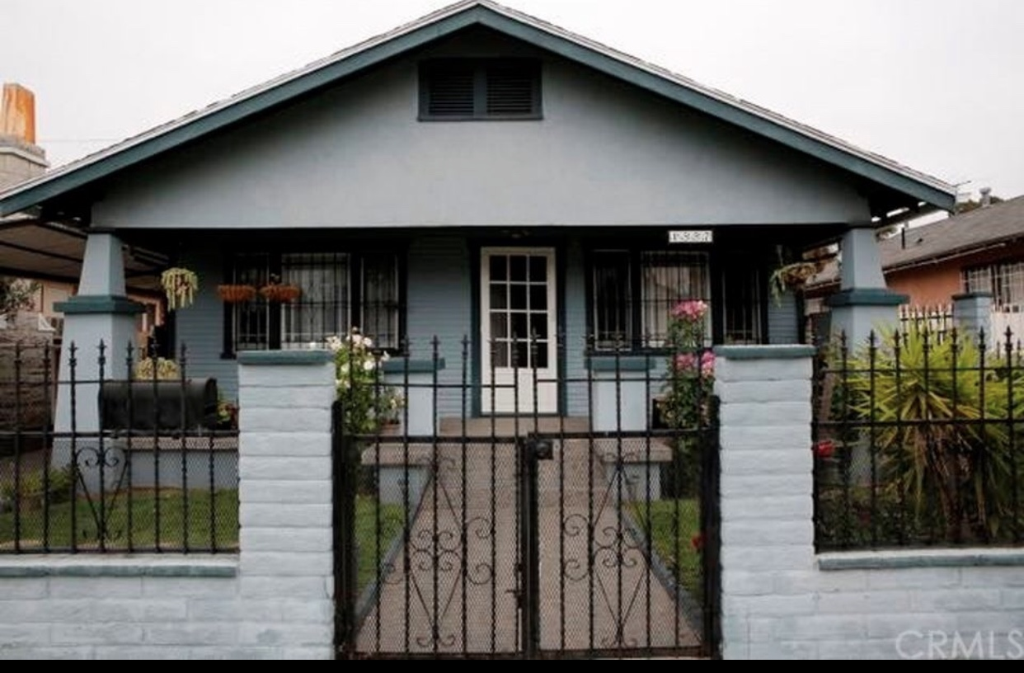
Property OWNED | Los Angeles
1557 West 29th Street, Los Angeles
Hubilu acquired this 7 bedroom property located 3 blocks from USC and the USC Village and a short distance to Metro Station. Property is a "turn key" purchase, will cash flow positive. Purchase price $643,000
Rental Unit | Current Monthly Rent | Future Monthly Rent | Close of Escrow | $643,000
1 | $900 | $925 | Current Valuation | $643,000
2 | $900 | $925
3 | $900 | $925 | Purchase Price | $643,000
4 | $900 | $925 | Carrying Costs | $5,000
5 | $900 | $925 | Fix Up Costs | $5,000
6 | $900 | $925 | Current Valuation | $643,000
7 | $900 | $925 | Mortgage | ($3,673)
 |  |  | Equity
Total | $6,300 | $6,475
Monthly Utilities | $500 | $500 | Current Annual Rent | $75,600
Current Annual Rent | $75,600 | $77,700 | Est. Annual Expenses | ($17,160)
Est. Annual Expenses | ($17,160) | ($17,160) | Annual Debt Service | ($44,076)
Annual Net Cash Flow | $58,340 | $60,540 | Annual Net Cash Flow | $14,364
Purchase, Clssing, and Fix Up Costs | $643,000 | $643,000 | Principal Reduction
Actual Cap Rate | 9% | 9.4% | Total Return | $10,440

Slide 13
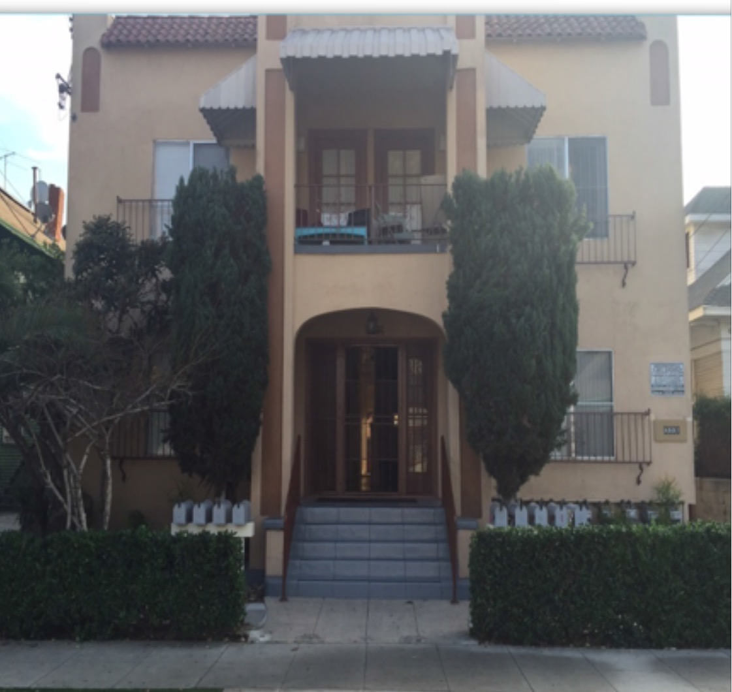
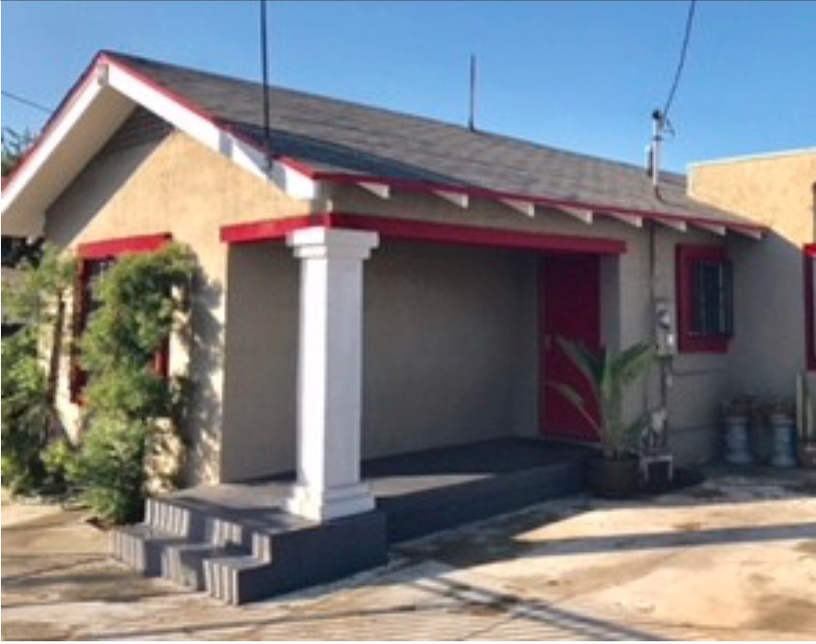
UNder Contract Acquisitions | Los Angeles
W. 28th St.,
Los Angeles
9 unit
15% rental upside
Cash Flow Positive
Walking distance to USC
Campus
Off-market listing
Exposition Blvd.
Los Angeles
Single Family
6 bed/2 bath
Cash Flow Positive
Walking distance to USC
Campus
1 Blk from Metro Station

Slide 14
BUSINESS ACQUISITIONS & PIPELINE
In addition to investing in real estate, we intend to diversify our investment portfolio and expand our revenue sources to include the acquisitions of profitable high growth businesses to increase our cash flow, including Property Management, CleanTech (Green), Healthcare, Intelligent Technology/Cloud, and e-Commerce (B2B, B2C). The following are a few companies we are in negotiations to acquire:
Property Management Company
A full-service property management company operating since 1991 that services over 250 apartment rentals and homes for rent in Southern California market. They employ a professional staff of licensed property managers trained to service every facet of property management that includes; accounting functions, maintenance and the day-to-day operations.

Slide 15
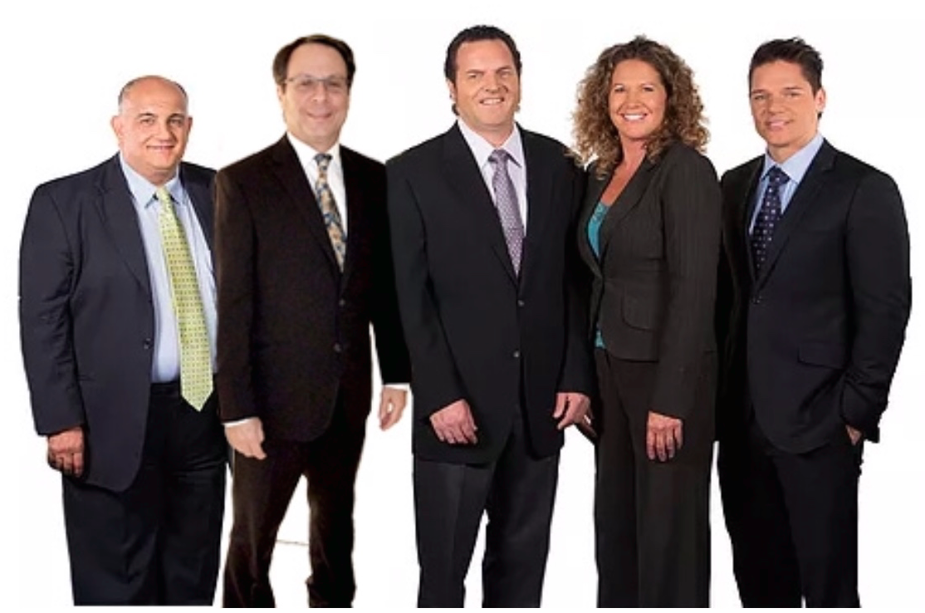
Seasoned management team with over 100 years combined experience in real estate and business acquisitions, development, property management, business development, marketing, operations, and sales.
Meet Our Management Team
David Behrend
Chief Executive Officer
Maurice Simone
VP and Secretary
Tracy Black
VP Investor Relations
Chille DeCastro
VP Marketing
Our Philosophy
Hubilu Venture Corporation’s vision is to seek out and acquire real estate and operating businesses that management believes has limited downside risk, is recession proof, and is in the path of growth to facilitate high rental income upside, positive cash flow and equity appreciation.
Eric Klein
VP Operations & Business
Development

Slide 16
Securities | equitY
Hubilu is seeking to raise $2,000,000 in Convertible Preferred Stock
Basic terms of the equity offering are as follows:
Price of $1.00/Convertible Preferred Stock, up to a maximum of 2,000,000 shares
Minimum investment required $20,000
Restricted stock for six months from date of issuance and until registered or 144
eligible
Thereafter, convertible into Common Stock by holder at the lesser of $0.50c, or a
conversion price set at 90% of the average closing Common Stock price for the
five most recent trading days prior to conversion
Offered only to accredited investors pursuant to a Purchase Agreement
Holder receives 5% dividend, PIK (payment-in-kind) interest during holding
period
Proceeds will be used to expand the real estate portfolio and operational costs.
Securities holders will own an undivided interest in the entire Hubilu portfolio of
multi-family properties

Slide 17
RETURN ON INVESTMENT (ROI)
Conversion of Convertible Preferred Stock (CPS) to Common Stock
Conversion Explanation (Investment) | $20,000 | $50,000 | $100,000
Convertible Preferred Stock Priced at $1.00 | 20,000 | 50,000 | 100,000
Dividend at 5%/yr (2.5% per 6 mo.) payable in CPS | 500 | 1250 | 2500
Total Convertible Preferred Stock after 6 months | 20,500 CPS | 51,250 CPS | 102,500 CPS
Common Stock trading at 20c Conversion to Common Stock after 6 months at 18c (10% discount) (20,500/18c) = 113,889 Common | 113,889 common shares | 285,722 common shares | 102,500 common shares
Profit 113,889 x 20c = $22,778 less original $20,000 | $2,778 | $6,944 | $13,888
6 Month ROI | 13.89% | 13.89% | 13.89%
Common Stock trading at 60c Conversion to Common Stock after 6 months at 50c (lesser of 50c or 54c) (20,500/50c) = 41,000 Common | 41,000 common shares | 102,500 common shares | 205,000 common shares
Profit 41,000 x $0.60 = $24,600 less original $20,000 | $4,600 | $11,500 | $23,000
6 Month ROI | 23% | 23% | 23%
Common Stock trading at $1.00 Conversion to Common Stock after 6 months at 50c (lesser of 50c or 90c) (20,500/50c) = 41,000 Common | 41,000 common shares | 102,500 common shares | 205,000 common shares
Profit 41,000 x $1.00 = $41,000 less original $20,000 | $21,000 | $52,500 | $105,000
6 Month ROI | 105% | 105% | 105%
For Illustration Purposes Only and NOT a Solicitation to Sell Securities.

Slide 18
Legal disclaimer
The information contained in this Investor Presentation has been prepared for potential institutional or accredited investors solely for the purpose of making an evaluation of Hubilu Venture Corporation (“Hubilu” or the “Company”) and does not purport to be comprehensive or contain all of the information contained herein, including financial projections related to future performance. Any such statements, estimates, and projections reflect various assumptions concerning anticipated results, which might or might not prove to be correct. Such statements might contain forward looking statements, as defined under federal and state securities laws, and no representation or warranties are made regarding the accuracy or completeness of such statements, estimates or projections. Prospective investors who might wish to pursue an investment in Hubilu will be provided with additional information, and any eventual investment agreement will contain mutually approved representations and warranties between the parties.
The information herein includes the Company’s key assumptions and projected financial and operations data. The Company believes the assumptions used to create these projections are reasonable, however, projections are necessarily speculative, and the Company cannot assure prospective investors that such projections will conform to actual results. The actual results realized during the future periods are likely to vary from the projections, and the variations might be material and adverse. The Company makes no representation or warranty as the accuracy, completeness, or reliability of this information. Prospective investors are encouraged not to place undue reliance on projected financial results.
Contact
David Behrend
CEO
(310) 308.7887
david@hubilu.com
@davidbehrendceo
Tracy Black
VP Investor Relations
(310) 420.9599
tracy@hubilu.com
@hubiluventure

